Slide 1
Strengths-Based Student Supervision
2019 MOTEC Fieldwork Educator Day

Slide 2
Learning Objectives
Participants will identify their strengths as a fieldwork educator
Participants will identify characteristics & models of effective student supervision
Participants will identify proactive tools and strategies to identify and support students’ strengths and manage (avoid!) problems
Participants will understand how to apply leadership theory to student supervision
Participants will apply theory, tools, and strategies to clinical scenarios
Notes:
And generate some ideas based on the strengths and the wisdom in the room

Slide 3
Strengths-based
Supervision
Leader
Teacher
Counselor
“Strengths-based supervision...is primarily a way of being with students, where attention is given to power with rather than over, and the environment is such that both fieldwork educator and student contribute their expertise to the relationship.”
-https://innovativeresources.org/strengths-based-supervision/
https://www.youtube.com/watch?v=eGaEAzqWeQQ
Fieldwork
Educator
Supporter
Consultant
Evaluator
Notes:
What is a strengths-based approach and why is it important?
A shift in focus away from weaknesses to strengths
Increases self-efficacy, moral, productivity, and commitment - motivation
In this way, we’re really looking at more of a collaborative supervision approach.
Watch video clip
It’s important to work from a strengths-based, rather than a deficit-based, perspective, both in terms of ourselves as well as working with students. We need to recognize that we and our students each bring strengths, experiences, and expertise to the supervisory relationship.
This is similar to understanding different learning styles and asking our students how they learn best, and having that understanding of ourselves, we can also seek to understand our own and our student’s areas of strength and use those as building blocks.
Fieldwork educators wear many hats (as you see in the graphic) and may have more strengths in one area vs another. FWE’s are leaders - will talk about later in the session.

Slide 4
“Like guides, we walk ahead of our students, at times beside them, and at times we follow their lead. In sensing where to walk lies our art. For as we support [them] in their struggle, challenge them toward their best, and cast light on their path ahead, we do so in the name of our respect for their potential and our care for their growth.”
-Daloz, 1999, p. 244

Slide 5
Identifying Strengths

Slide 6
Strengths in the Room
Divide into groups based on generation:
Baby Boomers (1943-1964)
Generation X (1965-1979)
Xennials (1977-1983)
Generation Y/Millennials (1980-1999)
Discuss your collective strengths as a generation
Write your top 5 strengths on the chart paper
Notes:
Post chart paper with strengths at front of room to reference
Debrief on collective strengths as a large group

Slide 7
Generation | Formative Events | Socialization | Values | Educational View
Baby Boomers 1943-1965 | Anti-war mvt, Civil Rights, Woodstock | Post-war prosperity, activism, increase in communism | Civil rights, reform, equality, optimism | Hardworking
Generation X 1968-1979 | Globalization, dot.com boom | Latchkey kids, parents as workaholics | Balance between work and life | Value continuous learning & skill development
Generation Y 1980-1999 | Terrorism, violence | Trophy kids, structured life, child-centric parenting, rewarded for effort vs performance | Innovation | Incredible expense, micromanaged by parents & expect that of educators

Slide 8
Generation | Strengths | Areas of Need | Work Ethic | Communication Style
Baby Boomers 1943-1965 | Loyal, workaholic | Wants it all, competitive, micro-managers | Paid dues (comes in early, stays late), climbs ladder, adventurous | Face to face
Generation X 1968-1979 | Independent, autonomous | Lack loyalty, skeptical reluctant to network | Job hop, outcome-focused | Like learning to be entertaining, allow innovation & creativity
Generation Y 1980-1999 | Curious, energetic, civil, tech savvy, not afraid of change, multitasking | Expect to make decisions, need to achieve, demanding, lack direction/focus, interpersonal skills, tries to negotiate vs earn | Entitlement & sense of validation, desire immediate result, rely on external motivation, lack maturity, lack self-confidence & self-esteem | Informal, need a lot more coaching & modeling on interprofessional skills, provide a voice, assign work groups, clarify big picture, mentor, work-life balance

Slide 9
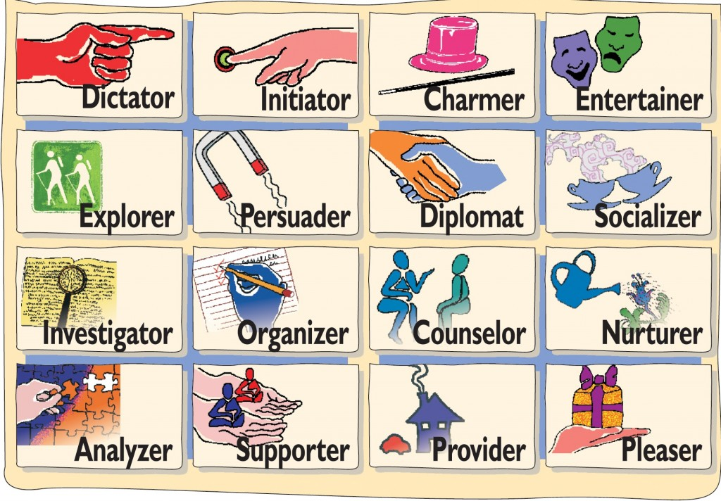
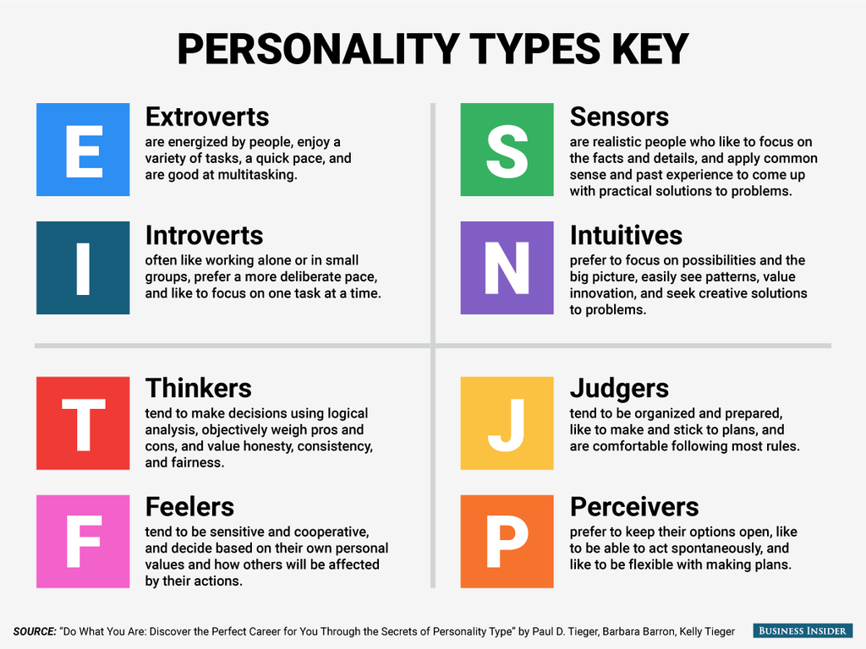
Resources for Identifying Strengths
CliftonStrengths
https://www.gallupstrengthscenter.com/home/en-us
Straight Talk Communication Tool (FREE!)
https://gostraighttalk.com/
Myers Briggs Personality Types
https://www.myersbriggs.org/my-mbti-personality-type/
http://www.humanmetrics.com/cgi-win/jtypes2.asp (FREE!)
Notes:
Lots of resources out there for identifying strengths in ourselves and in our students
Any other examples you have used?
Bring StrenghtsFinder book

Slide 10
Identifying Personality Type & Corresponding Supervisory Strengths & Characteristics
Identify your personality type using the handout based on the Myers Briggs Personality Inventory
Write your personality type (letters) on the sticky tag and place it on your person
Find a partner who has a different personality type from your own
Using the Characteristics & Strengths of Supervisory Personality Dimension handout, discuss your strengths and areas of growth in terms of supervision with your partner
Notes:
Hand out Myers Briggs Personality Sheet
Hand out Characteristics & Strengths of Supervisory Personality sheet
5. Debrief as a large group

Slide 11
Characteristics of Effective Fieldwork Educators & Models of Effective Student Supervision

Slide 12
Characteristics of Effective Fieldwork Educators
Sets clear and appropriate expectations up front
Builds a good rapport with student
Collaborates with student and others
Individualizes type and level of supervision to student needs
Provides clear, specific, timely feedback
Demonstrates strong clinical skills
Demonstrates professionalism and ethical behavior
Demonstrates good interpersonal communication and skills

Slide 13
How to Give Strengths-Based Feedback
Adopt a strengths-based approach as the primary means for giving feedback
Identify student’s strengths
Provide positive feedback based on those strengths
Ask student to improve by making continued use of strengths
Closely link any negative feedback to knowledge and skills rather than talents or personality
Focus on observable behavior - not personality, praise, advice, or motivation
Prioritize feedback - should be the amount a student can handle, not how much we want to give
Notes:
Hand out Weekly Meeting Form sample
Knowledge and skills are changeable whereas talents and personality are less so

Slide 14
Ineffective Models of Student Supervision
No-model Model
Assumption that good clinician = good supervisor
Supervisor has no training in supervision or education
Lots of time spent putting out fires, don’t know what to do proactively
Expert Model
Top down, no collaboration
Student role is passive; student is expected to be “mini me” of supervisor
One Size Fits All Model
What worked for one student works for all student, no adaptability
Ignores adult learning theory
Students as Patients Model
Supervision feels like a psychotherapy session, supervisor “fixes” student
Notes:
The research tells us that there are some really ineffective models of supervision that just don’t work.
I bet some of us experienced these when we were doing our fieldwork

Slide 15
Effective Models of Supervision
Psychotherapy-based Models
Rooted in psychotherapy; help develop clinical expertise along with personal growth
Developmental Models
Look at students’ professional development as they progress through clearly define stages
Most commonly cited is Novice to Expert
Social Role Models
Emphasize various professional roles in performing supervision
Recognize supervision is similar to but distinct role from teaching, counseling, consulting, or therapy
Situational Leadership Model
Identify student needs, adjust leadership style, collaborate with student to develop the needed skills
Notes:
And the research tells us that there are many effective models of supervision and these are…go through first 3. No way we can go through all of these, just know they exist and check out some of the references for more information.
However, it’s not one-size fits all (as we saw on the previous slide). It really takes selecting the model that works best for you based on your style and strengths and for your particular student.
Which is where this Situational Leadership Model comes in. The is actually more of a leadership/management model but there’s been some research to show that it has been effective in nursing and athletic training.

Slide 16
Situational Leadership

Slide 17
Situational Leadership Model
Originally developed in the 60’s by Paul Hersey with further development in 1996 with Blanchard & Johnson.
No one best approach or style for effectively influencing the behavior of others
Dependent on the individual and situation
Focus on the task and the individual’s motivation on performance
Requires ability to adapt leadership style to provide level of support and direction dictated by performance needs of an individual for a task.
https://www.youtube.com/watch?v=5qD_6yIKXbo
Notes:
Reflection question - How does this model apply to fieldwork education?
Leadership = Influence
Like the PEO of supervision
Student examples: high motivation, low skill (JH) and low motivation, high skill (MB)

Slide 18
Situational Leadership Model
Situational leaders demonstrate four core competencies:
Competency | Action
Diagnose - understand the task in need of influence | Define task at lowest common denominator and determine readiness of the individual
Adapt - adjust behavior in response to the situation | Objectively and intentionally identify the influence approach that aligns with diagnosis
Communicate - interact in a manner that others understand and accept | Deliver the leadership style with clarity and consistency
Advance - manage the movement toward higher performance | Accelerate the development and redirect the regression of others.

Slide 19
Situational Leadership Model
Step 1: Diagnose (see previous slide)
Step 2: Determine individual’s ability and willingness to perform
How much task specific knowledge or experience does the individual demonstrate?
Is the individual confident, committed and motivated to perform this task?

Slide 20
Situational Leadership style
Directive behavior: extent in which the leader engages in defining roles, structuring activity and directing what to do for a particular task.
Supportive behavior: extent in which the leader engages in two-way communication, facilitates interaction and actively listens

Slide 21
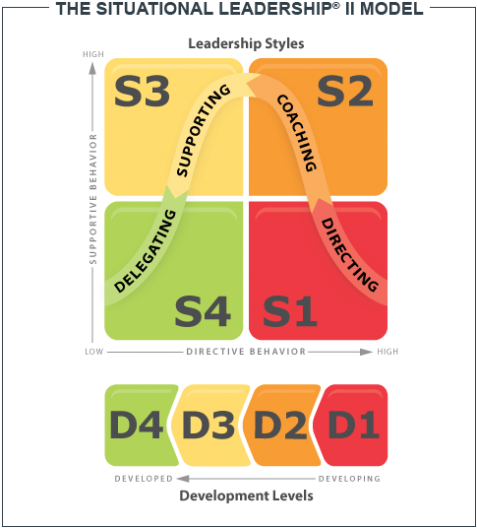
Leadership styles
Telling or directing (structuring or guiding)
Supervisor provides direction and explicit
instruction - close supervision
Selling or coaching (explaining)
Supervisor clarifies rationale, recognizes
enthusiasm of student, ensures understanding,
provides opportunities to ask questions - moderate supervision
Participating or supporting (involving)
Collaboration in decision making process-
establishing alignment - moderate to low supervision
Delegating (entrusting)
Trust the student to leverage their own base of
experience to perform the task
Notes:
https://www.youtube.com/watch?v=sGCxEP8R6MQ

Slide 22
Reflection Questions
Which style resonates with you the most?
What kinds of students does each style work best with?
What kinds of student situations are the most challenging?
Notes:
Discuss questions in table groups
Share out with large group

Slide 23
When to Use Each Style
Telling or directing
“I don’t know what to do and I’m afraid I’m going to make a mistake.”
Student demonstrates low level of readiness, insecurity.
Selling or coaching
“I’m not sure what to do, but I’m eager to learn.”
Student doubts their abilities but is willing to try

Slide 24
When to Use Each Style Cont.
Participating or supporting
“I have a good understanding of what to do, I’m just not sure I’m ready to do it on my own.”
Student demonstrates moderate level of readiness, still insecure in their abilities.
Delegating
“I know what I’m doing and truly enjoy doing it.”
Student’s level of readiness is high and they are confident in their abilities.

Slide 25
Characteristics of a Situational Leader
Insight: The situational leader must be able to understand the needs of the followers, then adjust his or her management style to meet those needs
Flexibility: Situational leaders must be able to move seamlessly from one type of leadership style to another
Trust: The leader must be able gain his or her followers’ trust and confidence
Problem solving: The situational leader must be able to solve problems, such as how to get a job done using the best leadership style available
Coach: The situational leader must be able to evaluate the maturity and competence of the followers and then apply the right strategy to enhance the follower and their personal character

Slide 26
Clinical Scenarios
Define the task
Is it a new task?
How complex is it?
Identify student readiness
How much task-specific knowledge does the student have?
Is the student confident, committed, and motivated to perform the task?
Identify the leadership style that’s most appropriate for this situation.
What would you do next in this situation?
Notes:
Scenarios 1, 3, and 5 on the flash drive from the Costa text (starting on p 259)
Discuss in small groups at table
Share out with large group
OTA becoming OT Complex case at week 12

Slide 27
References
What Differentiates the Situational Leader? (2018). Retrieved from
https://www.situational.com/what-differentiates-the-situational-leader/
What is Situational Leadership? How Flexibility Leads to Success. (2014). Retrieved from
https://online.stu.edu/articles/education/what-is-situational-leadership.aspx
The Situational Leadership II Model. (2019). Retrieved from
https://www.kenblanchard.com/Products-Services/Situational-Leadership-II
Strengths-based Feedback
https://uwm.edu/mcwp/strengths-based-feedback/
Costa, D.M. (2007). Clinical supervision in occupational therapy: a guide for fieldwork and practice. Bethesda, MD: AOTA Press.
DeIuliis, E. (2017). Professionalism across occupational therapy practice. Thorofare, NJ: SLACK Incorporated.

