Slide 1
Michigan OTA Programs

Slide 2
Baker College Muskegon
Katy Potter, MS, OTRL
Program Director
kathryn.potter@baker.edu
(231) 777-5289
Cassie Kregger, BA, COTA/L
Academic Fieldwork Coordinator
cassie.kregger@baker.edu
(231) 777-5316
Program Format
1 year general education + 15 months in program + 16 weeks Level II FW
Competitive application process
Summer Start 20 students

Slide 3
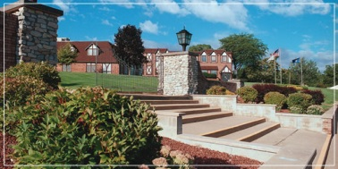
Baker College of Owosso
OTA Classes start in Summer 1yr + 1yr including Level I Fieldwork
+ Level II FW 16 weeks
24 students per class
Annette Horton, PhD, OTRL
Program Director
annette.horton@baker.edu
Wendy Flint, BBA, COTAL
Academic Fieldwork Coordinator
wflint01@baker.edu

Slide 4
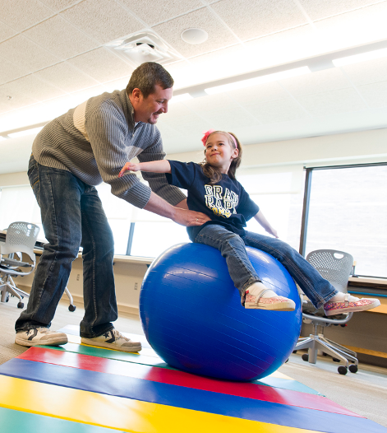
Admits 28 students each fall
Level 1 fieldwork is faculty supported & completed in the community
Mental health: Homeless population
Home Health: Virtual
Employment accommodations
Level II Fieldwork in winter: 56-60 placements needed
Program Director
Matt Mekkes, MS, OTR
mmekkes@grcc.edu
Academic Fieldwork Coordinator:
Robin Pegg, EdDc, MEd, COTAL, ATP, ROH
robinpegg@grcc.edu
(616)234-4344

Slide 5
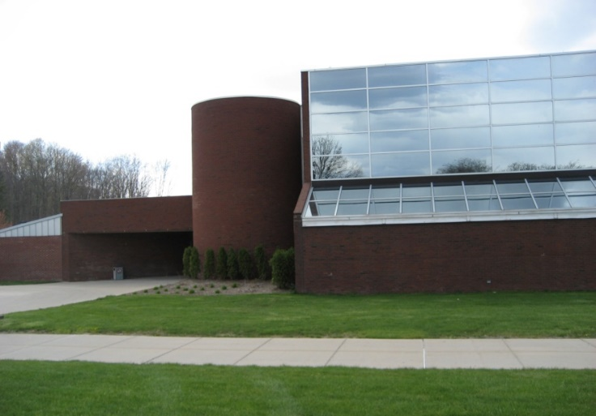
Pennie Wysocki, BS, COTAL
wysockip242@macomb.edu
Level I Fieldwork - First Placement: Psychosocial/Mental Health Second Semester
Placements January to March - March to May or Summer
One day a week 8 hours X 8 weeks = 64 hours
Level I Fieldwork - Second Placement: Physical Dysfunction Third Semester
Placements August to October - October to December
One day a week 8 hours X 8 weeks = 64 hours
Level II Fieldwork - Fourth Semester
Placements January to March - March to May
Program Coordinator: Mariea Seefried
Seefriedm@macomb.edu

Slide 6
Mott Community College
Anne Crites, OTRL
Academic Fieldwork Coordinator
anne.crites@mcc.edu
(810) 762-5020
Southern Lakes
Branch Campus
2100 W. Thompson Road
Fenton, MI 48430
24 Student Fall Admission
Study Abroad 1 Week-Costa Rica
Level I FW=116 hours
Peds-1day/wk x 6wks=36
Jan-Feb or March-April
Adults-2wks x 40hrs=80
Late March/Early April
Summer Camp Optional
Level II FW=8wks x 2
May/June, July/August

Slide 7
Western Michigan University
Level I Fieldwork:
2 semester-long experiences, 8 hours a week
Internal clinics servicing the community
Level II Fieldwork :
January – February = 8 weeks
March – April = 8 weeks
2023: 12 placements
2024: 28 placements
Bachelor of Science: Occupational Therapy Assistant
Academic
Fieldwork Coordinator:
Sara Clark, MS, OTRL sara.clark@wmich.edu

Slide 8
Michigan OT Programs

Slide 9
Baker College – Royal Oak
In Spring Semester 2023, the MSOT Program moved to the new Baker College – Royal Oak campus
Dean and Program Director
Annette Horton, PhD, OTRL
annette.horton@baker.edu
248.276.5540
Academic Fieldwork Coordinator
Sheila Guiao, MSOT, OTRL
sheila.guiao@baker.edu
248-276-8263
MSOT Program
Admit 40 students each Fall
Level I Fieldwork
Pediatric (Summer)
May-July or July-August
20 hours, suggested schedule 2-4 hrs./wk.
Adult (Fall)
September-December
70 hours, suggested schedule 8 hrs./wk.
Psychological & Social Factors (Fall)
September-December
Small group experience, schedule varies
Level II Fieldwork
January – March
April – June

Slide 10
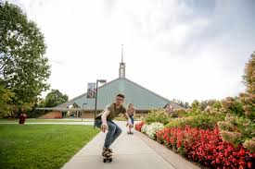
Concordia University-Ann Arbor
Candidacy Status-OTD (entry-level)
Level I Rotations:
March-May 2024
Level II Rotations
May- August 2024
August - November 2024
28 students maximum
Curriculum uses Transactional Model and Occupational Therapy Intervention Process Model to guide learning and holistic care
Currently seeking clinical partners for fieldwork and capstone experiences
IPE experience with PT, RN, SW, Education, Child Life with standardized patients and high fidelity simulation
Team Stepps trained for improved interprofessional communication
Fieldwork Contact Capstone Contact
Jennifer Engja, OTD, MSOT, OTRL Nicole O. Hansen, Dr.OT, MS, MOT, OTRL
Academic Fieldwork Coordinator/ Capstone Coordinator/
Assistant Professor Assistant Professor
Jennifer.engja@cuaa.edu Nicole.hansen@cuaa.edu
734.995.7369 734.995.7228

Slide 11
Susan Dee Owens , MS, OTRL
Academic Fieldwork Coordinator
susan.owens@davenport.edu
(616) 871-6159
Fieldwork Highlights
Level IA: Four Weeks – Full Time Immersion – (May-August)
Level IB: Internal Student Clinics - (Behavioral Health)
Level IC: Internal Student Clinics - (Assisted Living)
Level II: 12 Weeks- Full Time – Two Rotations –
(May-August)(September-December)
Post Baccalaureate MSOT
Admit 29 Students in Fall
W. A. Lettinga Campus in Grand Rapids

Slide 12
Eastern Michigan University
Admit 38 students each January
Three Faculty Guided Level Is
Level IIs in Winter & Spring
Curricular Threads:
Occupation-Based Practitioner
Community-Minded Practitioner
Evidence-Driven Practitioner
Enterprising Practitioner
Curious Practitioner
Program Director:
Andrea Zakrajsek, OTD, MS, OTRL, FNAP
Academic Fieldwork Coordinator:
Melissa Peters, OTR/L
mpeter54@emich.edu

Slide 13
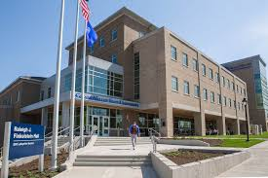
Level II Academic Fieldwork Coordinator
Breanna Chycinski, OTD, OTRL, PNAP
chycinbr@gvsu.edu
Level I Academic Fieldwork Coordinator
Kelsey Jewett, MS, OTRL
jewettk@gvsu.edu
Two Master’s Degree Programs (Fall Admission)
Traditional (40 / year); Hybrid (22 / year)
Level I (240 hours total); three 80-hour/semester rotations
Child and Adolescence (fall or winter semester)
Physical Disability & Rehabilitation (summer or fall semester)
Psychosocial (summer or fall semester)
International Level I (Guatemala and Ecuador)
Level II rotations
January-March
April-June
Post-Professional Doctorate- First cohort began January 2020
https://www.gvsu.edu/grad/drot/

Slide 14
Master of Science in Occupational Therapy
Admit 60 students each Spring
Curriculum emphasizes community-based learning, simulation, evidence-based practice, professionalism, and interprofessional education
Student research projects published nationally
Annual SOTA conference
Level I Fieldwork Model: 3 rotations, 1 day/week x 12 weeks
Aligned with concurrent coursework content; weekly seminar class to reflect on fieldwork experiences
Year 1 (Winter): physical conditions, 80 hr. min
Year 2 (Fall): psychosocial conditions, 80 hr. min
Year 2 (Winter): service-learning, 40 hr. min
Level II: Spring and Fall
Academic Fieldwork Coordinator
Stacey Webster, OTD, MSOT, OTRL
(989) 964-4331
srwebste@svsu.edu
Simulation Laboratory Associate
Kadie Schultz, MSOT, OTRL
(989) 964-4540
kmweber@svsu.edu

Slide 15
Doctor of Occupational Therapy (OTD)
Julie Jacob, DHSc, MSOT, OTRL
Interim Program Director
jjjacob@umich.edu
Julie Jacob, DHSc, MSOT, OTRL
Clinical Assistant Professor
Interim Academic FW Coordinator
jjjacob@umich.edu
Marra Cornelius, OTD, OTRL
Clinical Assistant Professor
Capstone Coordinator
marrac@umich.edu
Michigan’s first entry-level OTD
ACOTE Accreditation granted in 2022
Interprofessional education opportunities
Learner-Centered Teaching Approach
Partnership with Michigan Medicine in Ann Arbor
Capstone experiences in a variety of settings
Offering Dual OTD/MBA Degree

Slide 16
Level I Fieldwork:
Three Level I fieldwork experiences corresponding with the life course sequence of our curriculum - 1 day per week x 10 weeks
Year 1 (Winter): Level I, experience I: Pediatrics & Adolescents (Birth-21)
Year 2 (Fall): Level I, experience II: Adults
Year 2 (Winter): Level I, experience III: Older adults
Level II Fieldwork:
Year 3 (Fall) – 12 weeks
Year 3 (Winter) – 12 weeks
Doctoral Capstone
Doctoral Capstone Project & Experience begins in May of Year 3 - 14 weeks

Slide 17
Wayne State University
34 students admitted each fall
Level I Fieldwork: Clinical medical model and community/psychosocial one –week experiences tied into courses throughout program, totaling 4 weeks.
Level II Fieldwork: Summer and fall rotations totaling 6 months. Medical and community/psychosocial-based fieldwork experiences.
Research I Extensive University: Specialized Laboratories: AT, Driving, Human Movement, Therapeutic Media, Instructional Technology, Animal Assisted, Play/SI based.
Collaborative Clinics: DEW and the PLAY clinic
OTCAS
On-site experiences in addition to their standard fieldwork experiences including; but not limited to:
The Rehabilitation Institute of Michigan, Children’s Hospital of Michigan, and various other pediatric, adult & geriatric facilities throughout the Metro Detroit area. Participation in faculty run clinics and programs such as Special Olympics Evaluations for local area schools, the DEW clinic, IPTV/IPE health science days, and the PLAY clinic at Wayne State University.
Doreen Head, PhD, OTRL
Academic Program Director
doreen.head@wayne.edu
(313) 577-5884
Kimberly Banfill, MOT, OTRL
Academic Fieldwork Coordinator, Assistant Professor
kbanfill77@wayne.edu
(313) 577-5883

Slide 18
Western Michigan University
Two Campuses:
Kalamazoo and Grand Rapids
ONE TEAM – ONE PROGRAM
Entry-Level OTD Program
Level I Fieldwork:
3 semester-long experiences, 8 hours a week
Internal clinics servicing the community
Level II Fieldwork :
July – December: 100 Placements
Doctoral Capstone:
January – April
First OTD cohort graduated in April 2023
Academic Fieldwork Coordinators:
Sara Clark, MS, OTRL sara.clark@wmich.edu
Cara Masselink, PhD, OTRL cara.masselink@wmich.edu
Capstone Coordinator:
Holly Grieves, OTD, OTRL
holly.grieves@wmich.edu

