Slide 1

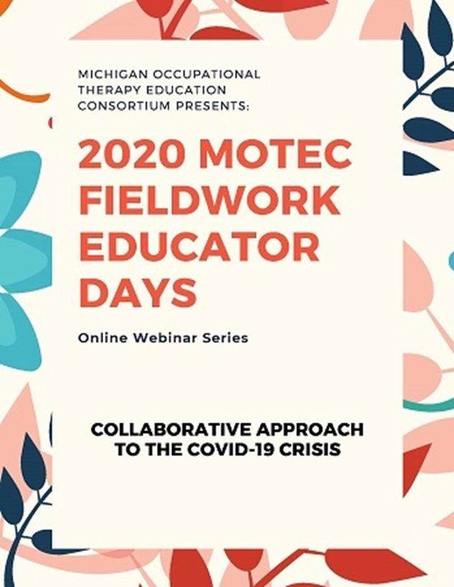
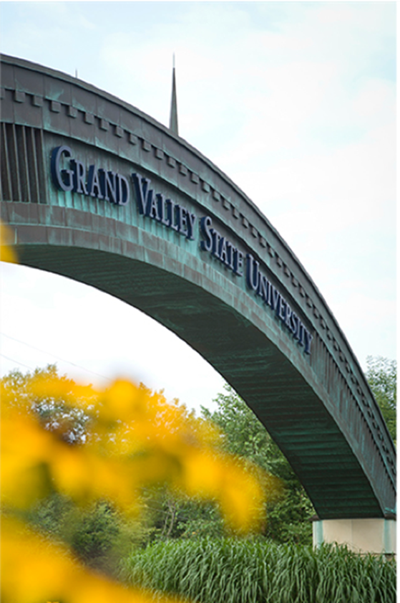
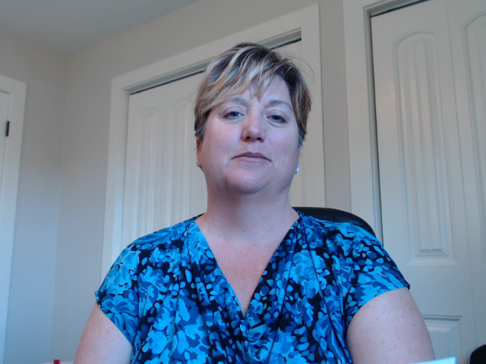

Slide 2
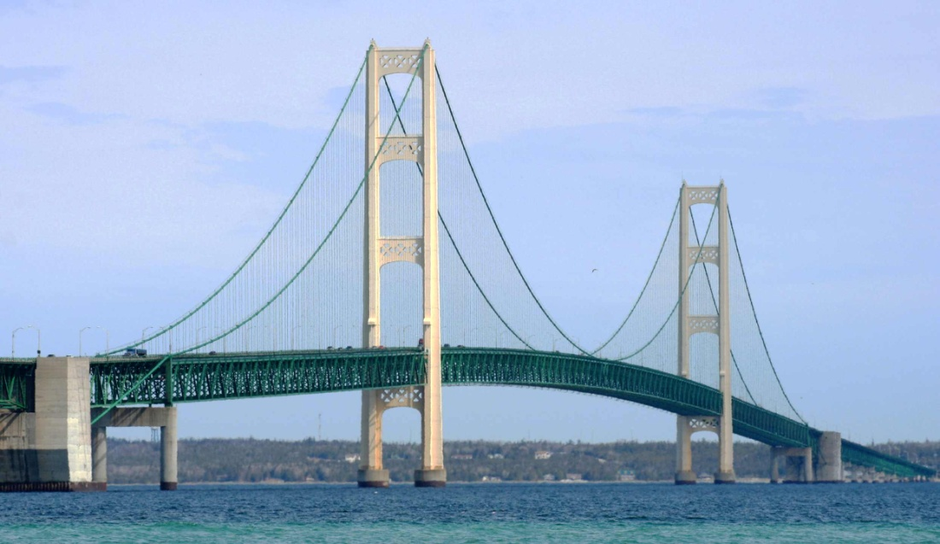

Michigan OTA Programs

Slide 3

Baker College Muskegon
Katy Potter, MS, OTRL
Program Director
kathryn.potter@baker.edu
(231) 777-5289
Wayne Doyle, DHSc, COTAL
Academic Fieldwork Coordinator
wayne.doyle@baker.edu
(231) 777-5316
Program Format
  1 year general education + 15 months in program + 16 weeks Level II FW
  Competitive application process
Summer Start 20 students

Slide 4
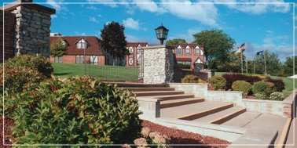
Baker College of Owosso
OTA Classes start in Summer 1yr + 1yr including Level I Fieldwork
+ Level II FW 16 weeks
24 students per class
Evelyn Greaux, MHSA, OTRL
Program Director
Evelyn.greaux@baker.edu
(989) 729-3466
Susan Williams, OTRL
Academic Fieldwork Coordinator
susan.williams@baker.edu
(989) 729-3482

Slide 5

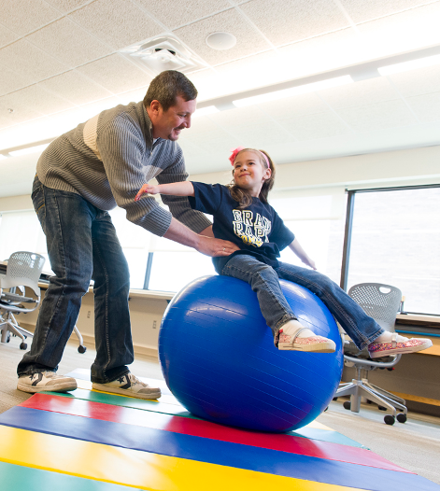

Admits 26-28 students each fall
  Level I Fieldwork in fall: 52-56 placements
  Level II Fieldwork in winter: 52-56 placements
Academic Fieldwork Coordinator:
Robin Pegg, MEd, COTA/L, ATP
robinpegg@grcc.edu
(616)234-4344

Slide 6

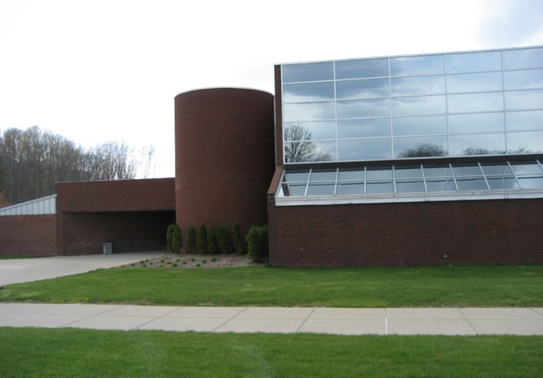
Pennie Wysocki, BS, COTAL
wysockip242@macomb.edu
Level I Fieldwork - First Placement: Psychosocial/Mental Health Second Semester
Placements January to March - March to May or Summer
One day a week 8 hours X 8 weeks = 64 hours
Level I Fieldwork - Second Placement: Physical Dysfunction Third Semester
Placements August to October - October to December
One day a week 8 hours X 8 weeks = 64 hours
Level II Fieldwork - Fourth Semester
Placements January to March - March to May

Slide 7

Mott Community College
Anne Crites, OTRL
Academic Fieldwork Coordinator
  anne.crites@mcc.edu
  (810) 762-5020
  Southern Lakes
  Branch Campus
  2100 W. Thompson Road
  Fenton, MI 48430
24 Student Fall Admission
2 Full-time Faculty, 6 Adjunct Faculty
Level I FW=116 hours
  Peds-1day/wk x 6wks=36
  Jan-Feb or March-April
  Adults-2wks x 40hrs=80
  Late March/Early April
  Summer Camp Optional
Level II FW=8wks
  May/June, July/Aug, Sept/Oct

Slide 8
Michigan OT Programs

Slide 9

Baker College
Flint/Auburn Hills
Fall 2020 MSOT Program moves to Auburn Hills Campus
Academic Fieldwork Coordinator
Annette Horton, MOT, OTRL
annette.horton@baker.edu
810-766-2221
MSOT Program
Admit 40 student each Fall
Level I Fieldwork
  Pediatric (Winter)
    February- April
    20 hours, suggested schedule 2-4 hrs./wk.
  Adult (Fall)
    September-December
    70 hours, suggested schedule 8 hrs./wk.
  Psychological & Social Factors (Fall)
    September-December
    Small group experience, schedule varies
Level II Fieldwork
  January – March
  April – June

Slide 10

Susan Dee Owens , MS, OTRL
Academic Fieldwork Coordinator
susan.owens@davenport.edu
(616) 871-6159
Fieldwork Highlights
Level IA: Four Weeks – Full Time Immersion – (May-August)
Level IB: Internal Student Clinics - (Behavioral Health)
Level IC: Internal Student Clinics - (Assisted Living)
Level II: 12 Weeks- Full Time – Two Rotations –
(May-August)(September-December)
Post Baccalaureate MSOT
Admit 29 Students in Fall
W. A. Lettinga Campus in Grand Rapids

Slide 11

Eastern Michigan University
Admit 38 students each January
Three Level Is (totaling over 198 hours!)
Level IIs in Winter & Spring
Curricular Threads:
  Occupation across the life course
  Practicing scholars
  Clinical and professional reasoning
  Social justice
  Community building
Program Director:
Tricia Foster, PhD
Academic Fieldwork Coordinator:
Melissa Peters, OTR/L
mpeter54@emich.edu

Slide 12
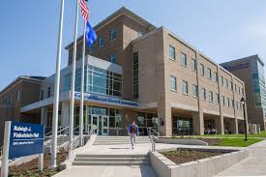
Level II Coordinator:
Breanna Chycinski, MS OTRL
chycinbr@gvsu.edu
Level I Coordinator:
Kristin Willey, MHS OTRL
willeykr@gvsu.edu
Two Master’s Degree Programs (Fall Admission)
  Traditional (40 / year); Hybrid (22 / year)
Level I (240 hours total); three 80-hour/semester rotations
  Child and Adolescence (fall or winter semester)
  Physical Disability & Rehabilitation (summer or fall semester)
  Psychosocial (summer or fall semester)
International Level I (Guatemala and Ecuador)
Level II rotations
  January-March
  April-June
Curriculum Emphasis- Critical thinking, occupation, EBP
Post-Professional Doctorate- First cohort began January 2020
  https://www.gvsu.edu/grad/drot/

Slide 13

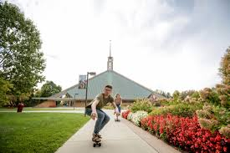

Concordia University Ann Arbor
Applicant Status
Scheduled to begin summer 2022
OTD (entry-level)
28 students
Currently accepting Advisory Board members
Fieldwork Coordinator position posting this summer
Contact:
Juliane Chreston, OTD OTRL
Founding Program Director
juliane.chreston@cuaa.edu
734.995.7596

Slide 14
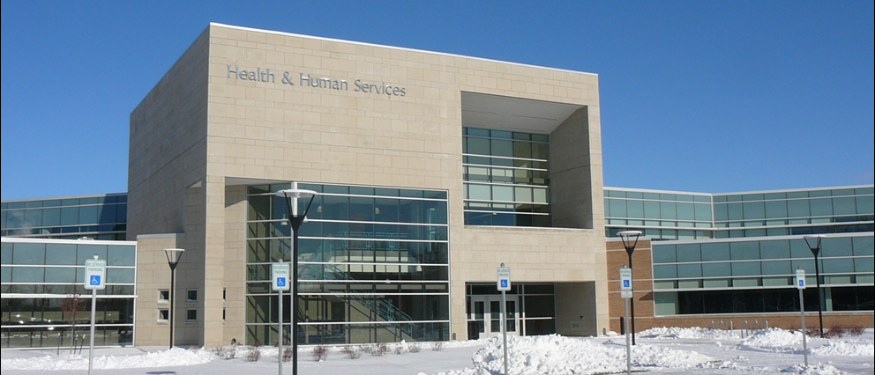
Saginaw Valley State University
Admit 60-65 students each Spring
Level I’s Winter and Fall Semesters, 1 day per week x 12 weeks
National student publications
International student travel
  China, Zambia, Ecuador
Annual SOTA conferences
Expansion of interprofessional education practice
Academic Fieldwork Coordinator
Julie Jacob, MSOT, OTRL
(989) 964-4331
jjhadden@svsu.edu
Level I Fieldwork Coordinator
Kadie Schultz, MSOT, OTRL
(989) 964-4540
kmweber@svsu.edu

Slide 15

SVSU's Level I Fieldwork Model
2 Level I Fieldwork Placements; each corresponds to concurrent didactic coursework
  Winter Semester of 1st year - Physical Disability rotation
  Fall Semester of 2nd year - PsychoSocial rotation; many have a non-traditional fieldwork placement
Each placement is 96 hours; 1 day per week over 12 weeks
Students attend a weekly fieldwork seminar course to reflect on progression of fieldwork/share experiences
Students have a number of assignments to complete including a case study, an occupation-based kit, client contact logs, occupational profiles; are expected to be as hands-on as possible; creating and implementing treatment plans/conducting all or parts of evaluations/assessments; etc.

Slide 16

Doctor of Occupational Therapy (OTD)
Michigan’s first entry level OTD
Interprofessional education opportunities
Learner-Centered Teaching Approach
Partnership with Michigan Medicine in Ann Arbor
Capstone experiences in a variety of settings
Offering Dual OTD/MBA Degree
Nancy Vandewiele Milligan PhD, OTRL, FAOTA
Program Director
nanmilli@umflint.edu
(810)424-5390
Wendy Tremaine, Ph.D., OTR/L
Clinical Assistant Professor
Academic FW Coordinator
wtremain@umich.edu

Slide 17

Level I Fieldwork:
3 Level I fieldwork experiences corresponding with life course sequence of our curriculum
Year 1: Level I, experience I: Pediatrics (Birth-21)
Year 2: Level I, experience II: Adults
Year 2: Level I, experience III: Older adults
Level II Fieldwork :
September 27-December 17, 2021 and January 3-March 25, 2022.
Doctoral capstone project and experience in May of 2022 (14 weeks).

Slide 18

Wayne State University
34 students admitted each fall
Level I Fieldwork: Clinical medical model, community based and pediatric related experiences
Level II Fieldwork: Summer and fall rotations. Medical and community based fieldwork experiences
Research I Extensive University: Specialized Laboratories: AT, Driving, Human Movement, Therapeutic Media, Instructional Technology, Schnebly Lab
Collaborative Clinics: DEW and the PLAY clinic
OTCAS
Doreen Head, PhD, OTRL
Academic Program Director, Assistant Professor
doreen.head@wayne.edu
(313) 577-5884
Kimberly Banfill, MOT, OTRL
Academic Fieldwork Coordinator, Assistant Professor
kbanfill77@wayne.edu
(313) 577-5883

Slide 19
Wayne State University, Level I Fieldwork
3 Level I Fieldwork Placements
  Each Level I placement is associated and coincides with a corresponding course.
    Fall Semester 2nd year: 1 week physical disability placement
    Fall Semester 2nd year: 1 week psycho-social placement
    Winter Semester 2nd year: 1 week pediatric placement
Students have assignments to complete that relate to their Level I fieldwork experiences and the coinciding courses.
  Treatment plans, daily logs, progress notes, intervention planning and application, standardized assessments, fieldwork roundtables with faculty post completion of Level I experiences, journals and threaded discussions, and completion of evaluation forms post completion of Level I.
  Students are also required to complete hours and related experiences in addition to their standard Level I fieldwork that correspond to various courses, including; but not limited to: The Rehab Institute of Michigan, Children’s Hospital of Michigan, and various other pediatric, adult & geriatric facilities throughout the Metro Detroit area. Participation in faculty run clinics and programs are also encouraged, such as Special Olympics Evaluations for local area schools, the DEW clinic, and the PLAY clinic at Wayne State University.

Slide 20

Western Michigan University
Two Campuses:
Kalamazoo and Grand Rapids
ONE TEAM – ONE PROGRAM
Level I Fieldwork:
2 semester-long experiences, 8 hours a week
Internal clinics servicing the community: students complete evaluations, carry a small caseload, complete documentation
Level II Fieldwork :
Jan-June: 40 Placements
July – December: 160 Placements
Doctoral Capstone:
First OTD cohort to complete doctoral capstone experience in Jan-April 2023
Academic Fieldwork Coordinator:
Sara Clark, MS, OTRL
sara.clark@wmich.edu
Capstone Coordinator:
Holly Grieves, OTD, OTRL
holly.grieves@wmich.edu

